Slide 1
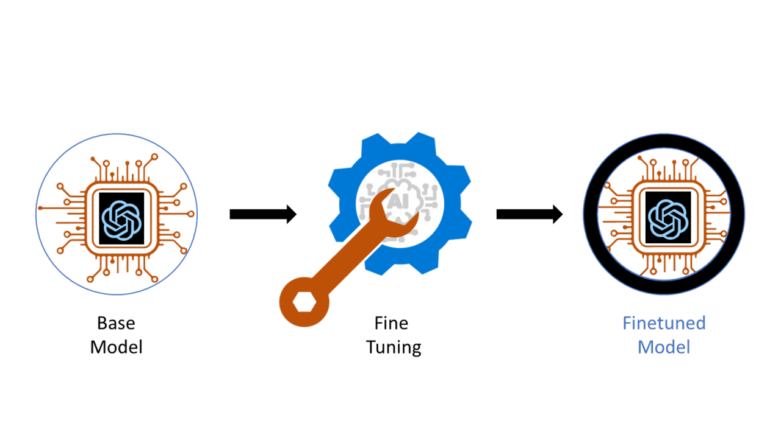
Toolformer & Gorilla
2.26.2026

Slide 2

Toolformer: Language Models Can Teach Themselves to Use Tools
Introduction
The Toolformer method enables a language model (LM) to learn on its own how to use external tools (like calculators, search engines, translators, etc.) through simple APIs, improving its performance on tasks it traditionally struggles with such as math, factual lookup, or up-to-date information retrieval without needing massive additional supervision.
Why Toolformer
Standard large language models are excellent at general language tasks but often lack basic functional skills (e.g., precise calculations or factual retrieval). Specialized models or tools excel at those tasks, but integrating them effectively with LMs has usually required either lots of human annotation or task-specific design.
How does it work?
Toolformer trains a base LM to:
Decide which tools (APIs) to use.
Determine when to call each tool.
Choose what arguments to provide.
Integrate the tool results into its own output generation.
1/28

Slide 3
Toolformer: Language Models Can Teach Themselves to Use Tools
Tool / API | Purpose / Functionality | How Toolformer Uses It
Calculator | Performs precise arithmetic | LM calls it when input requires math-accurate results (e.g., compute expressions)
Question Answering (QA) System | Returns factual answers to natural language queries | Used when the model needs factual information beyond its internal knowledge
Search Engine(s) | Retrieves up-to-date text results (e.g., wiki search) | LM uses it to get up-to-date information or web context
Machine Translation System | Translates text between languages | Called when a translation task is needed
Calendar API | Handles dates and scheduling | Used when the input involves temporal/date reasoning
2/28

Slide 4
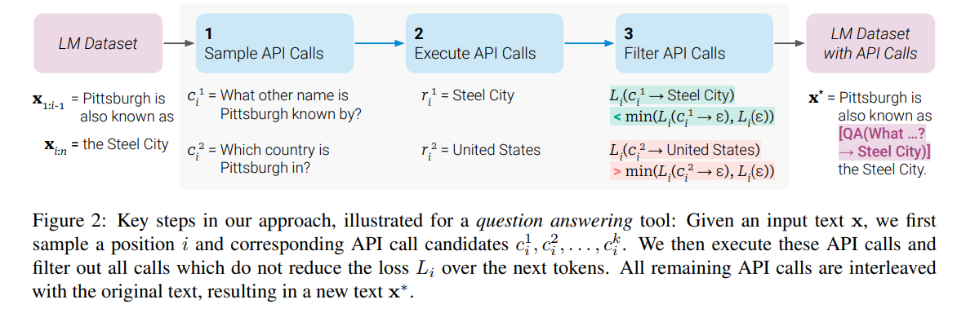
Toolformer: Language Models Can Teach Themselves to Use Tools
3/28

Slide 5
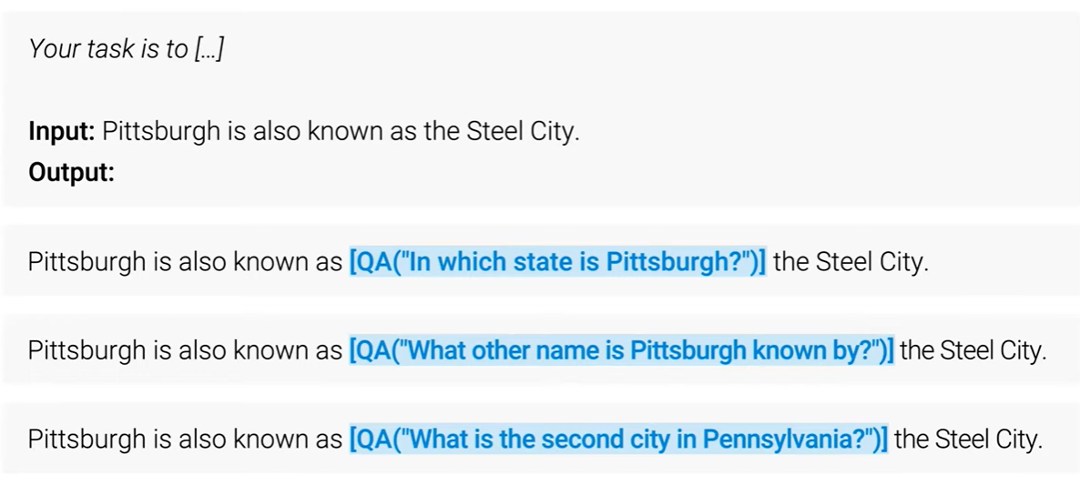
Toolformer: Language Models Can Teach Themselves to Use Tools
4/28

Slide 6
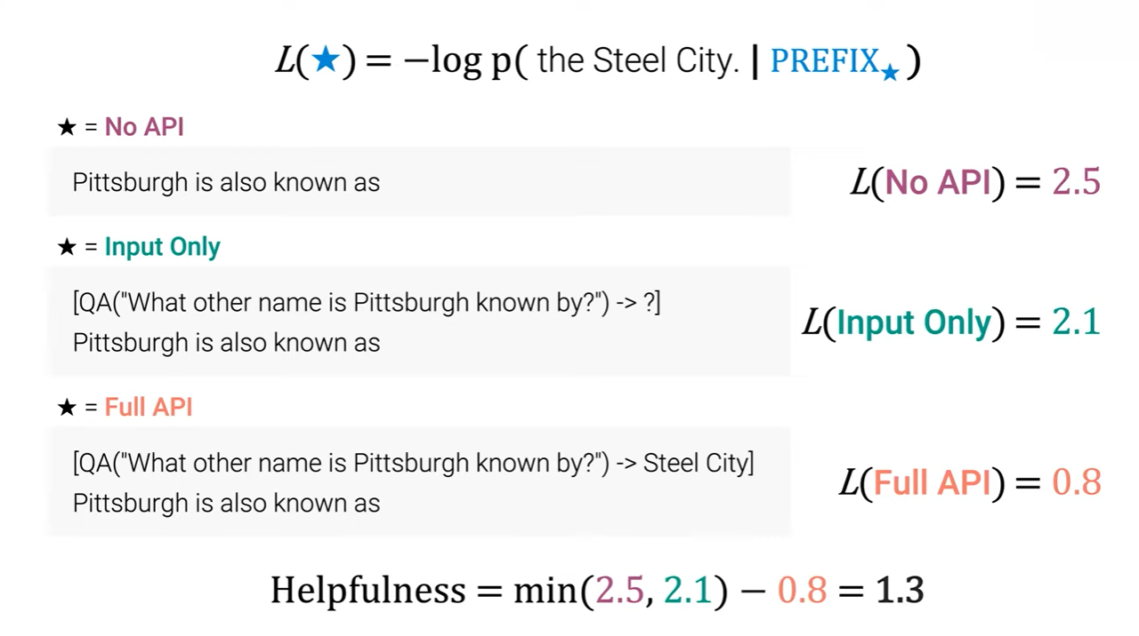
Toolformer: Language Models Can Teach Themselves to Use Tools
5/28

Slide 7
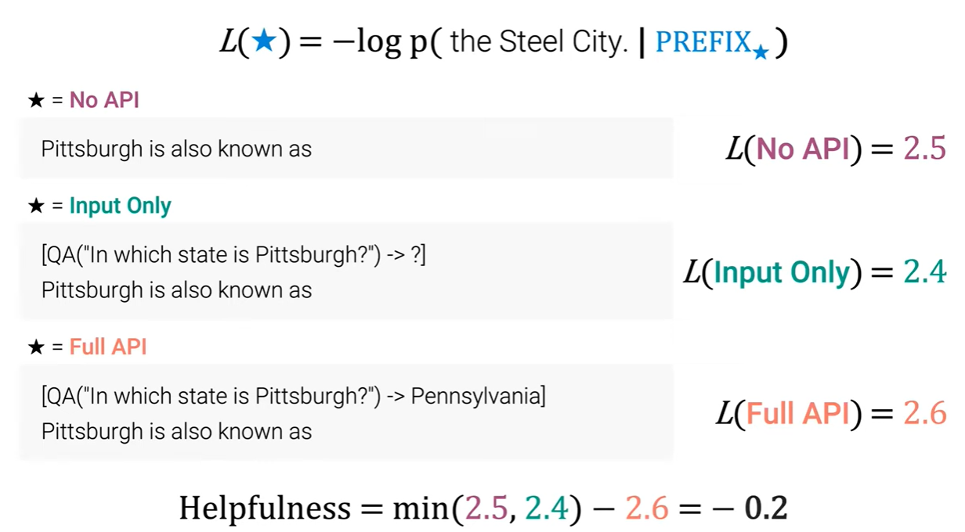
Toolformer: Language Models Can Teach Themselves to Use Tools
6/28

Slide 8
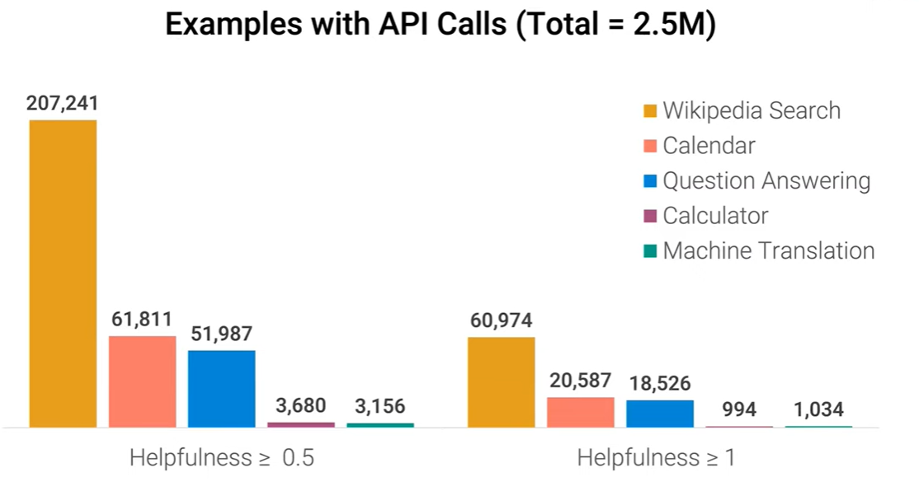
Toolformer: Language Models Can Teach Themselves to Use Tools
7/28

Slide 9
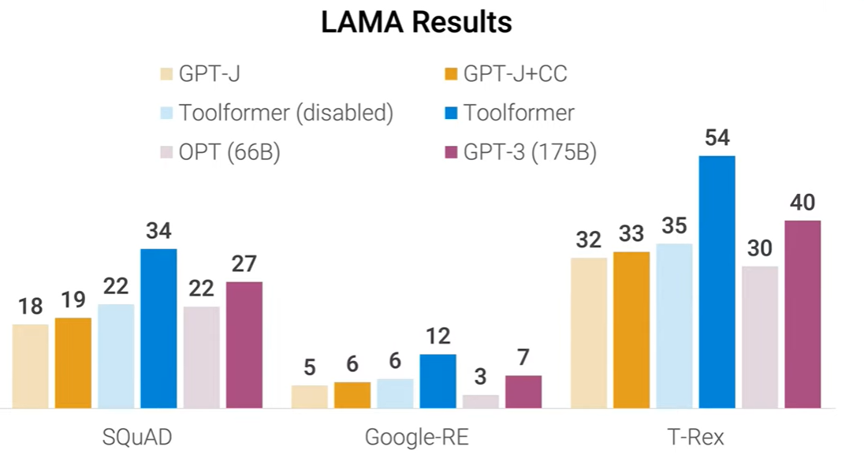
Toolformer: Language Models Can Teach Themselves to Use Tools
8/28

Slide 10
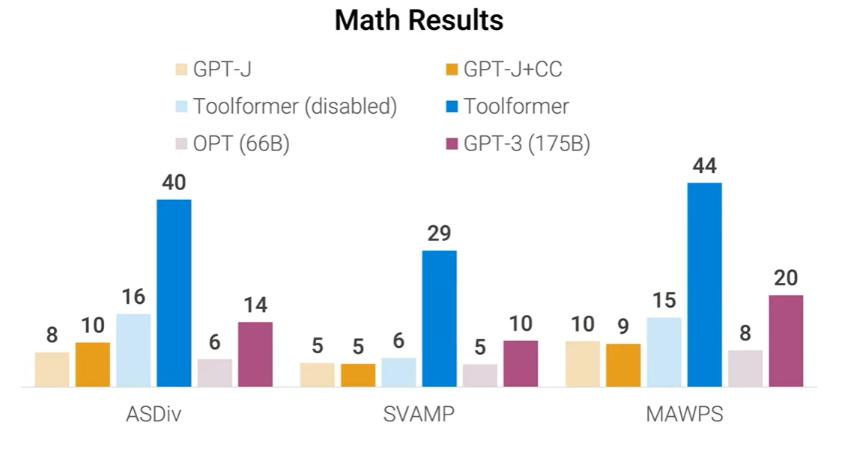
Toolformer: Language Models Can Teach Themselves to Use Tools
9/28

Slide 11
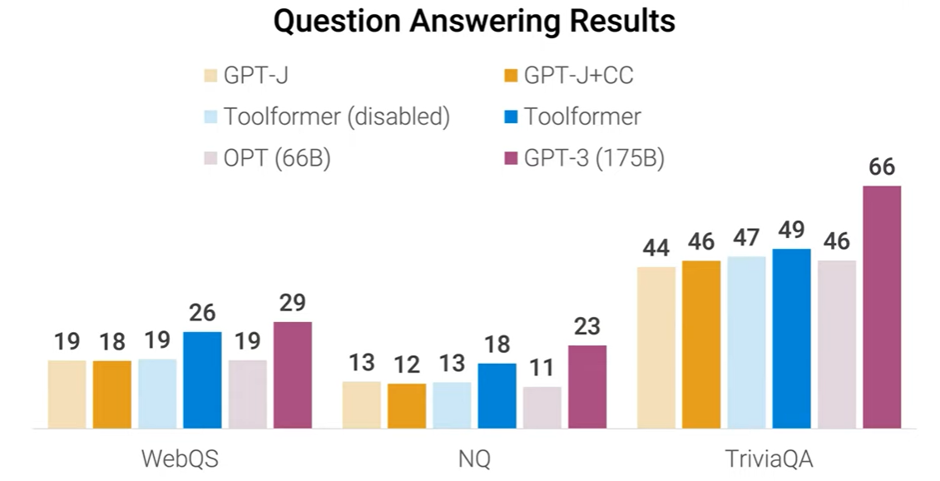
Toolformer: Language Models Can Teach Themselves to Use Tools
10/28

Slide 12
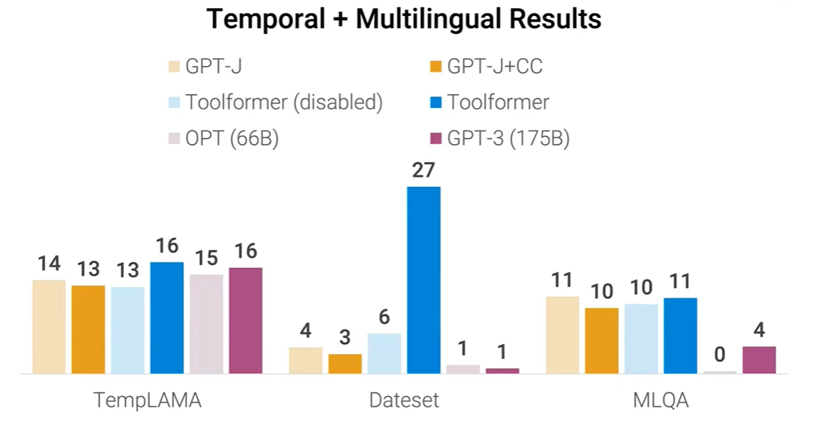
Toolformer: Language Models Can Teach Themselves to Use Tools
11/28

Slide 13
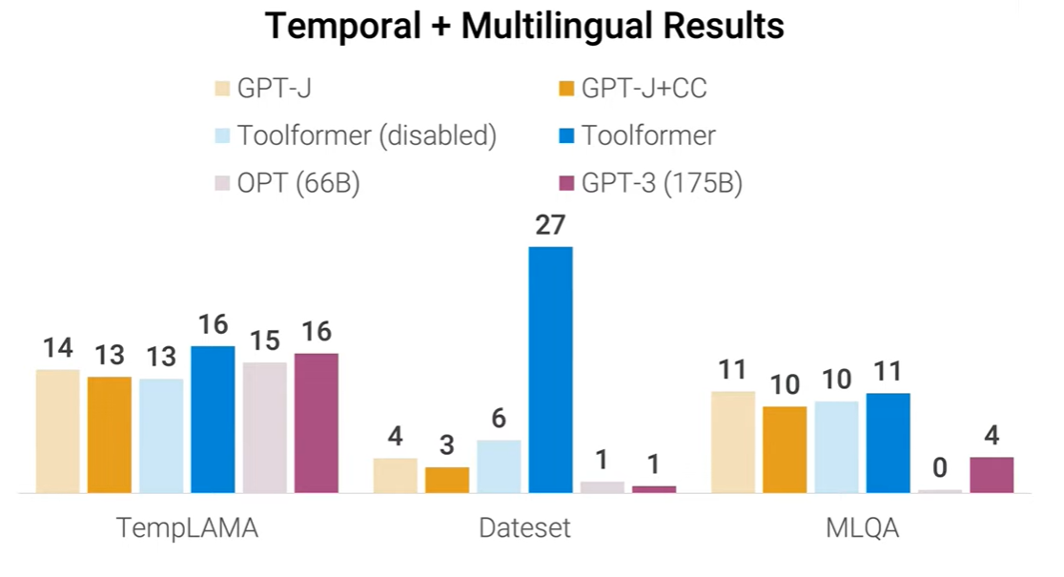
Toolformer: Language Models Can Teach Themselves to Use Tools
12/28

Slide 14
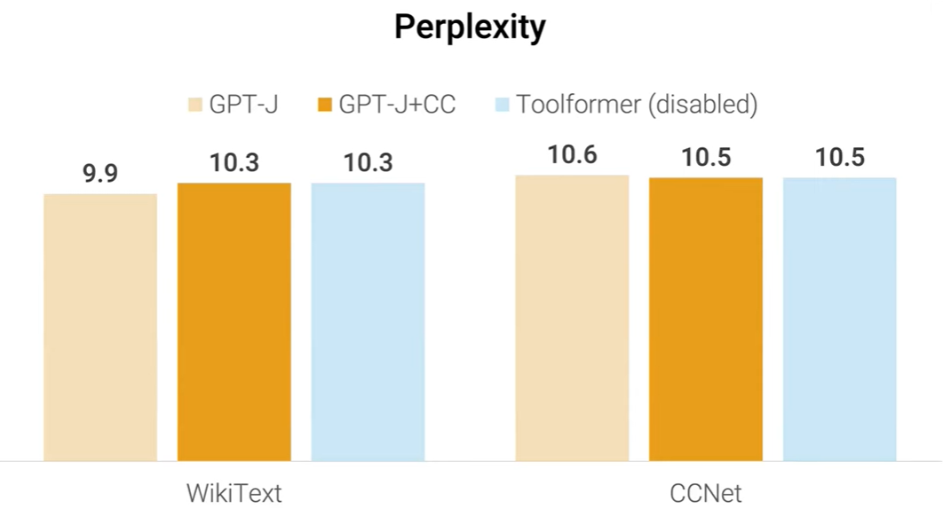
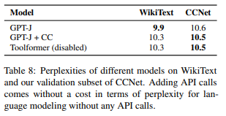
Toolformer: Language Models Can Teach Themselves to Use Tools
13/28

Slide 15
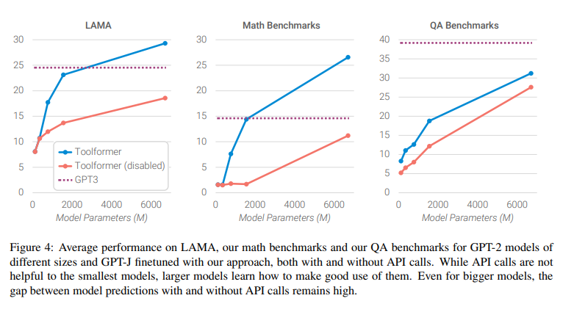
Toolformer: Language Models Can Teach Themselves to Use Tools
14/28

Slide 16

Toolformer: Language Models Can Teach Themselves to Use Tools
QUESTIONS

Slide 17
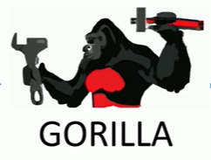
Gorilla: Large Language Model Connected with Massive APIs
Background and Problem
LLMs have made significant advances in tasks such as mathematical reasoning and program synthesis.
Despite this progress, effective use of tools via API calls remains a major challenge.
Even state-of-the-art models (e.g., GPT-4) struggle with:
Generating accurate API input arguments
Hallucinating incorrect or invalid API usage
Proposed Solution and Method
Gorilla is introduced as a fine-tuned, LLaMA-based model designed for accurate API call generation.
Gorilla outperforms GPT-4 in writing correct API calls.
When combined with a document retriever, Gorilla:
Adapts to test-time documentation or version changes
Allows flexible user updates
Significantly reduces API hallucinations
Evaluation and Impact
APIBench is introduced as a comprehensive benchmark using HuggingFace, TorchHub, and TensorHub APIs.
Results show that retrieval-augmented models like Gorilla can:
Use tools more accurately
Stay aligned with frequently updated documentation
Improve the reliability and real-world applicability of LLM outputs
Gorilla’s code, model, data, and demo are publicly available at https://gorilla.cs.berkeley.edu.
15/28

Slide 18
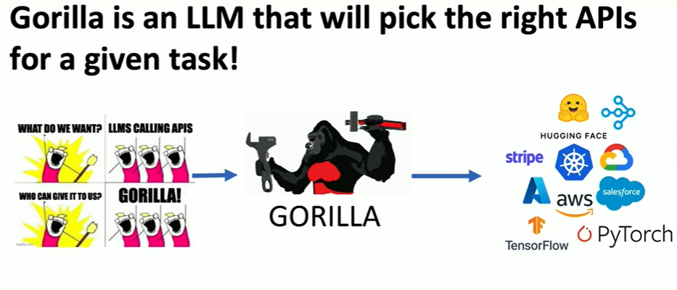
Gorilla: Large Language Model Connected with Massive APIs
16/28

Slide 19
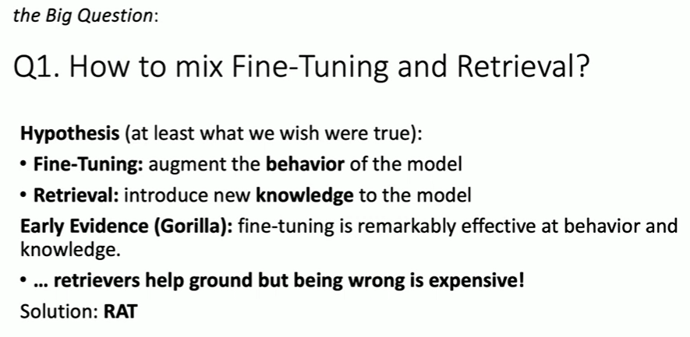
Gorilla: Large Language Model Connected with Massive APIs
17/28

Slide 20
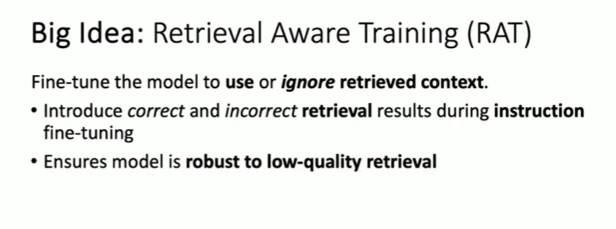
Gorilla: Large Language Model Connected with Massive APIs
18/28

Slide 21
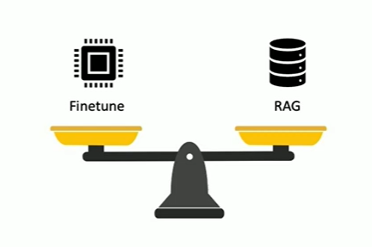
Gorilla: Large Language Model Connected with Massive APIs
19/28

Slide 22
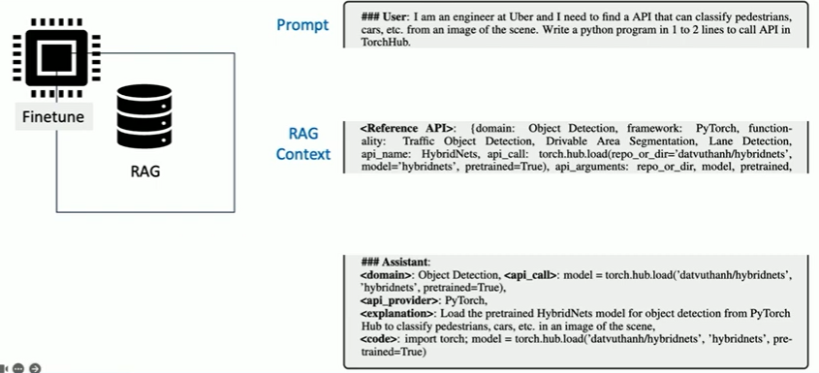
Gorilla: Large Language Model Connected with Massive APIs
Retrieval Aware Training
20/28

Slide 23
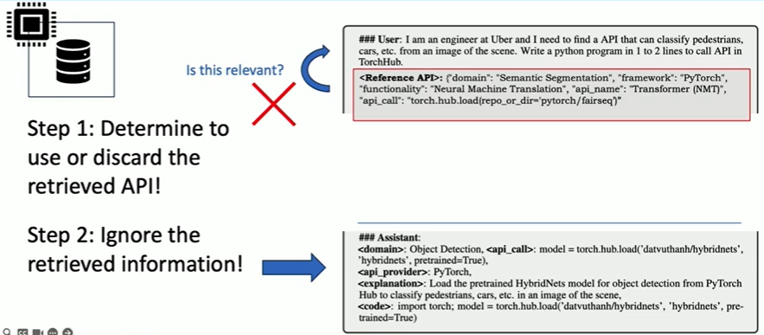
Gorilla: Large Language Model Connected with Massive APIs
Retrieval Aware Training
If the retrieved API is not relevant the discard and use what was learned during pretraining or finetuning
21/28

Slide 24
Gorilla: Large Language Model Connected with Massive APIs
How much does GPT -4 Hallucinate?
22/28

Slide 25
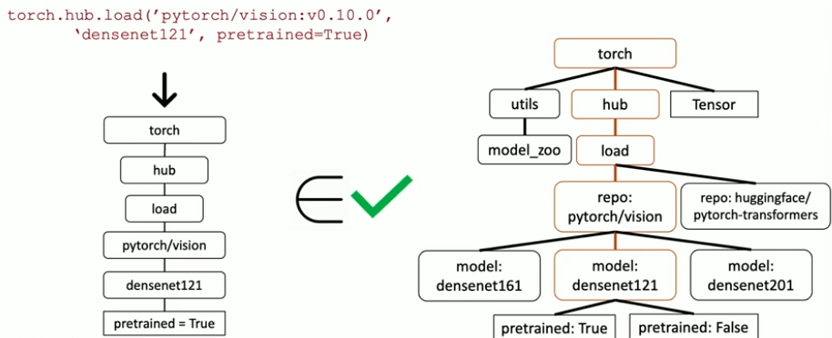
Gorilla: Large Language Model Connected with Massive APIs
AST sub-tree matching – measure Hallucination
Abstract Syntax Tree (AST)
23/28

Slide 26
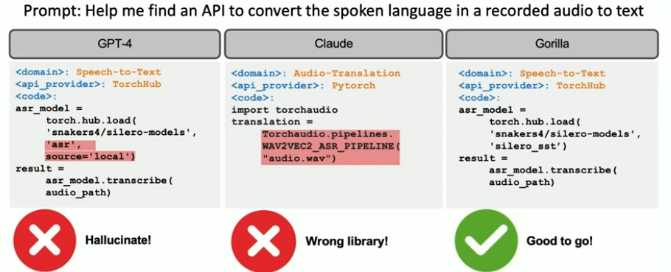
Gorilla: Large Language Model Connected with Massive APIs
State of the Art LLMs can not reliably call API because of inaccuracy and hallicunation
24/28

Slide 27
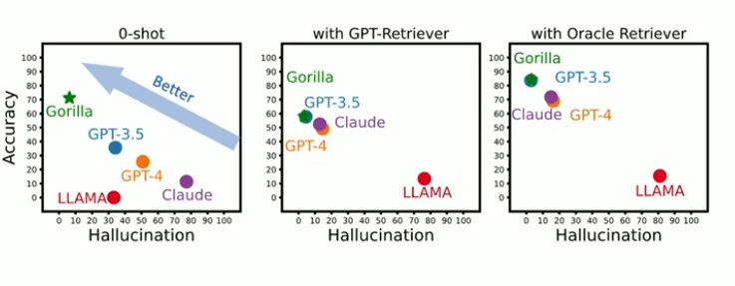
Gorilla: Large Language Model Connected with Massive APIs
Accuracy vs Hallucination
25/28

Slide 28
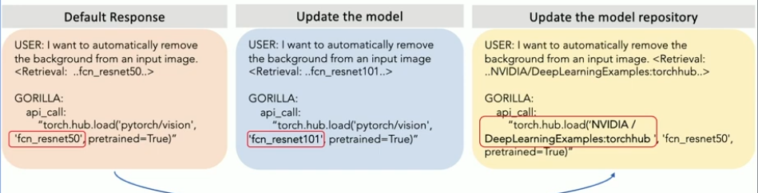
Gorilla: Large Language Model Connected with Massive APIs
Gorilla adapts to evolving APIs
26/28

Slide 29
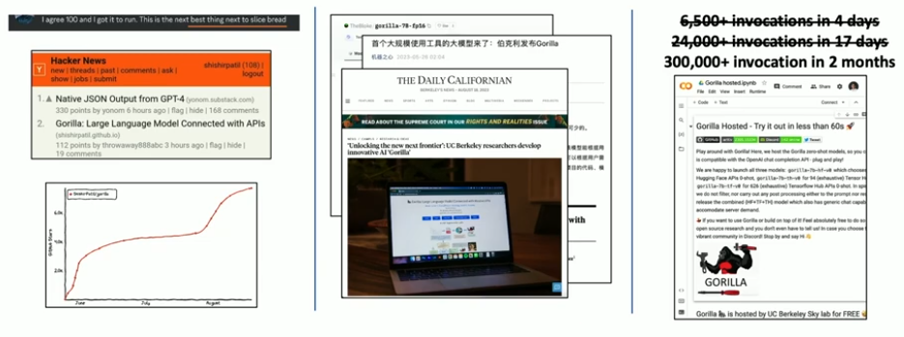
Gorilla: Large Language Model Connected with Massive APIs
Gorilla Impact
Next best thing to slice bread
Made front page news multiple times
Domestic and international press highlights
Increased usage over time
27/28

Slide 30
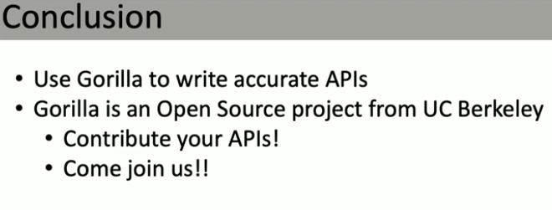
Gorilla: Large Language Model Connected with Massive APIs
Gorilla Impact
28/28

Slide 31
Gorilla: Large Language Model Connected with Massive APIs
QUESTIONS

Slide 32
END
2.26.2026

